Slide 1
Weight of Evidence Binning
Oli Cairns

Slide 2
Agenda
Logistic Regression - linearity assumption
Weight of Evidence Binning - explanation
Automated ‘binning’ using decision trees
Python implementation demo
Home Credit - Benchmarking & Interpretability
Limitations & mitigation strategies

Slide 3
All Models are Wrong….
“All models are approximations. Essentially, all models are wrong, but some are useful. However, the approximate nature of the model must always be borne in mind” George E. P. Box.

Slide 4
Logistic regression – linearity assumption (1)
Observations’ score is sum of features * model coefficients, mapped to probability using logistic function
4 → 88.1%
0 → 50.0%
-5 → 4.7%
Assumption that regressors have linear relationship with score, the log-odds of the probability
Example: company age increases default risk
age 10 years → 20 years
log-odds 0 → 0.5
default prob. 50.0% → 62.2%
age 10 years → 30 years
log-odds 0 → 1.0
default prob. 50.0% → 73.1%
Mapping from log-odds → probability

Slide 5
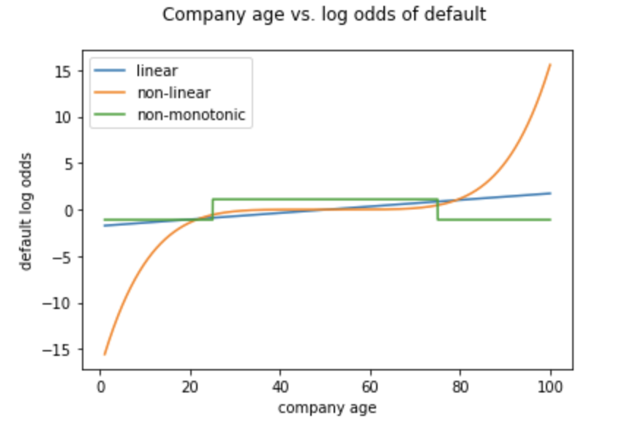
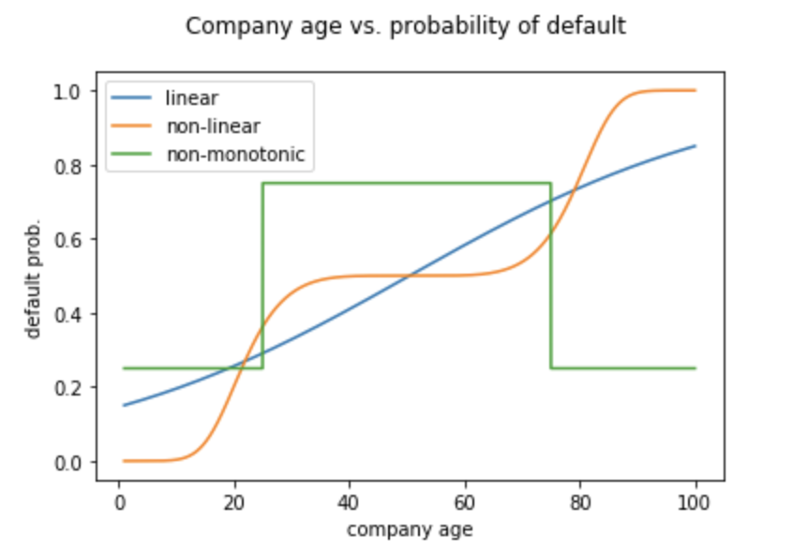
Logistic regression – linearity assumption (2)

Slide 6
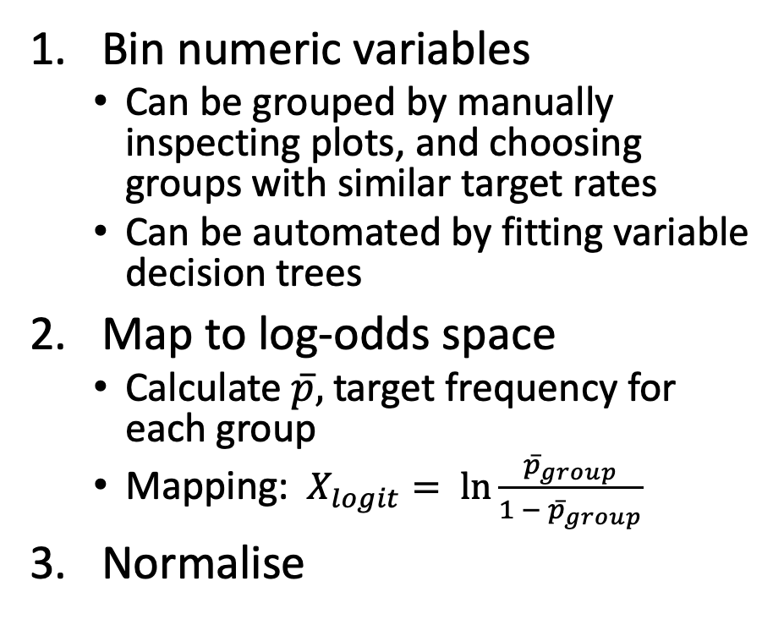
Weight of Evidence Binning - Overview
Bin numeric variables
Can be grouped by manually inspecting plots, and choosing groups with similar target rates
Can be automated by fitting variable decision trees
Map to log-odds space
Calculate $\overline{p},$ target frequency for each group
Mapping: $X_{logit}= \ln{\frac{{\overline{p}}_{group}}{1 − {\overline{p}}_{group}}}$
Normalise
Categorical
Numeric
Binning
Categorical - binned
Log Odds Scaling
Numeric – Log odds Scaled
Normalise

Slide 7
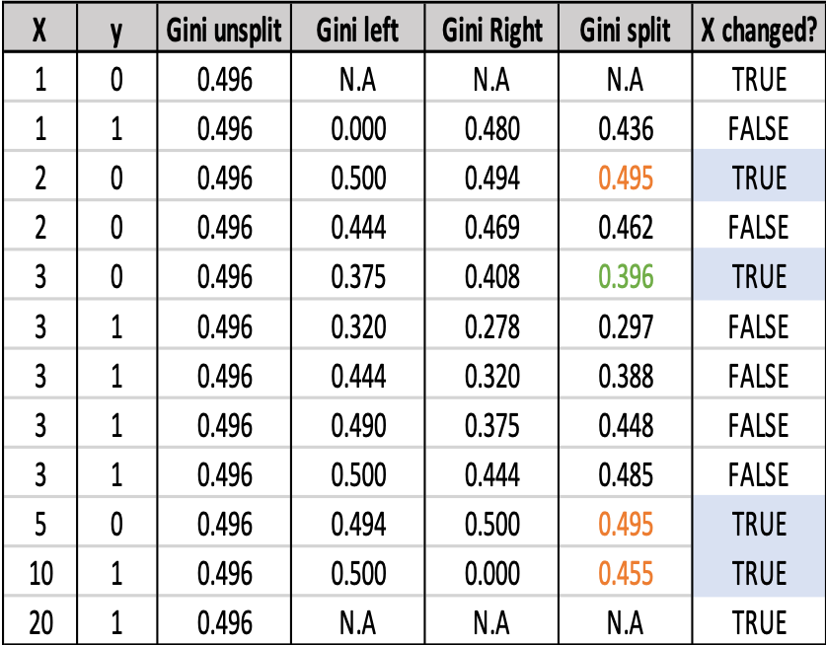
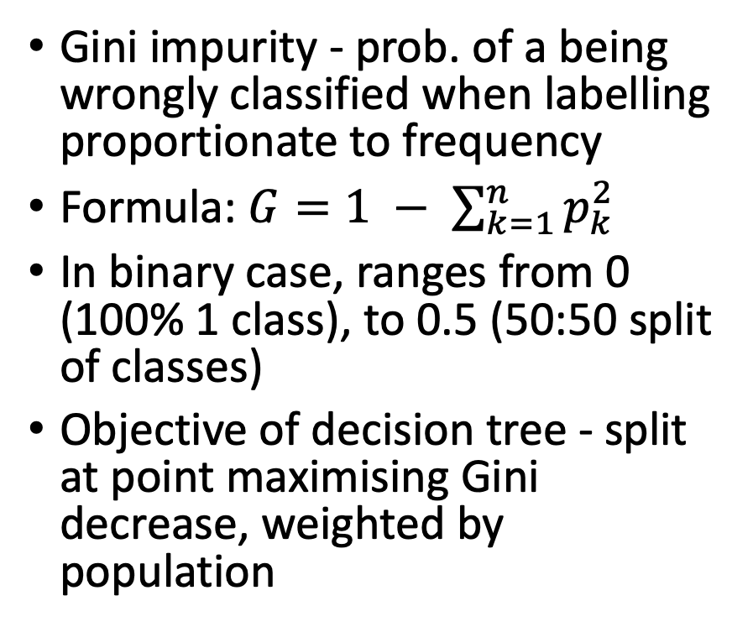
Decision tree variable binning (1)
Gini impurity - prob. of a being wrongly classified when labelling proportionate to frequency
Formula: $G=1 − \sum_{k=1}^{n}{p_{k}^{2}}$
In binary case, ranges from 0 (100% 1 class), to 0.5 (50:50 split of classes)
Objective of decision tree - split at point maximising Gini decrease, weighted by population

Slide 8
Decision tree variable binning (2)
Recursive ‘greedy’ approach
Split data, maximising Gini impurity decrease, creating ‘left’ and ‘right’ nodes
Further split both nodes, again maximising Gini impurity decrease, disregarding candidates not achieving:
Minimum Gini impurity decrease
Minimum number of entries in left/right Node
Stop at maximum depth, leaf nodes of tree are ‘bin’ thresholds

Slide 9
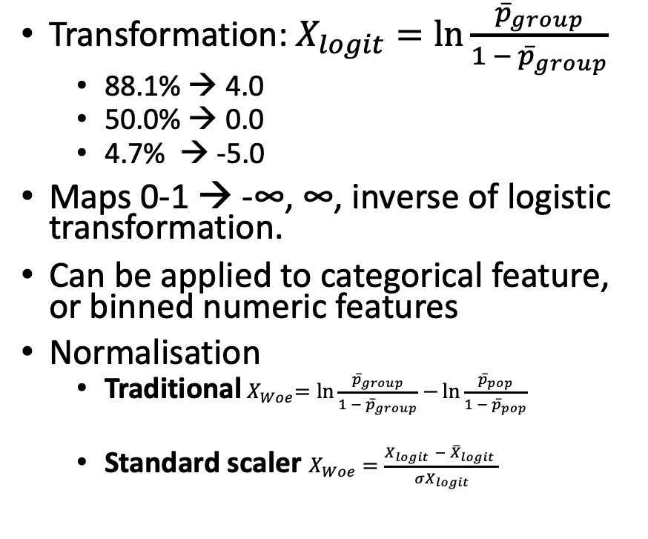
Log odds transformation
Transformation: $X_{logit}=\ln{\frac{{\overline{p}}_{group}}{1 − {\overline{p}}_{group}}}$
88.1% → 4.0
50.0% → 0.0
4.7% → -5.0
Maps 0-1 → -∞, ∞, inverse of logistic transformation.
Can be applied to categorical feature, or binned numeric features
Normalisation
Traditional${ X}_{Woe}=\ln{\frac{{\overline{p}}_{group}}{1 − {\overline{p}}_{group}}}−{\ln{\frac{{\overline{p}}_{pop}}{1 − {\overline{p}}_{pop}}}}$
Standard scaler $X_{Woe}=\frac{X_{logit }− {\overline{X}}_{logit} }{{σX}_{logit}}$
Company Age | Obs. | Default count | Default rate | Logit - default rate
age < 19 | 18 | 5 | 28% | -0.956
19 <= age < 79 | 61 | 50 | 82% | 1.514
age >= 79 | 21 | 7 | 33% | -0.693

Slide 10
Limitations
No guarantee of monotonicity
Manually adjust bins, or enforce monotonicity
Sensitive to hyperparameters
Tuning, e.g. Random Search or Bayesian Hyperparameter tuning
Instability with high-cardinality categories
‘Otherise’ low-frequency categories
Map to lower cardinality, using domain expertise, or similarity metrics, such as string distance.
Does not model interactions
Can manually encode interactions
Benchmark vs. more flexible models, e.g. tree-ensemble/neural net

Slide 11
Useful resources
Scorecardpy Python Weight of Evidence Binning Library
Listendata article Weight of evidence binning explained
Victor Zhou article Gini Impurity explained
Towardsdatascience Article Decision tree implementation
Code from this talk can be found here

